Slide 1
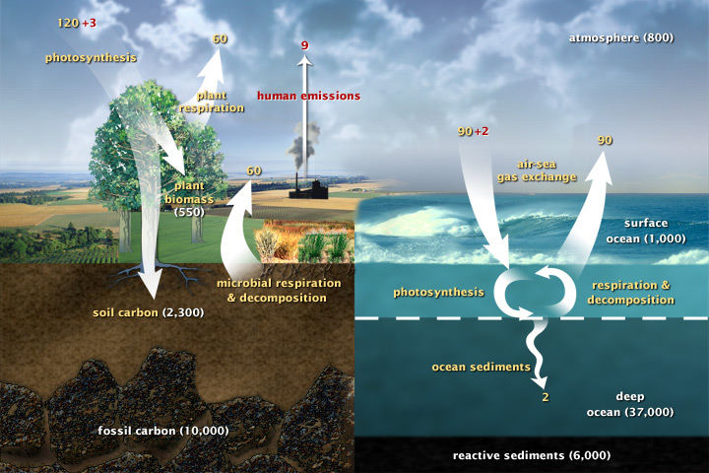
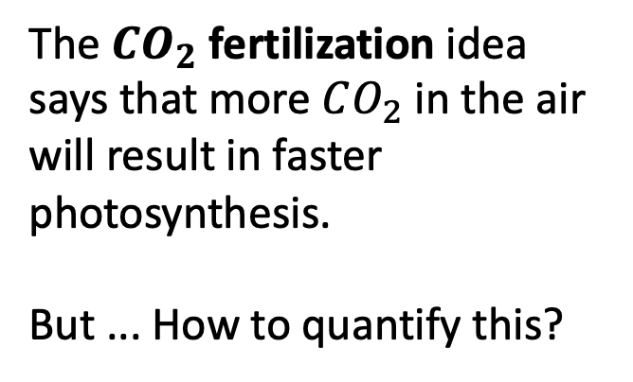
Carbon fluxes in Earth’s climate system
The $CO_{2}$ fertilization idea says that more $CO_{2}$ in the air will result in faster photosynthesis.
But ... How to quantify this?
(377 ppm)

Slide 2
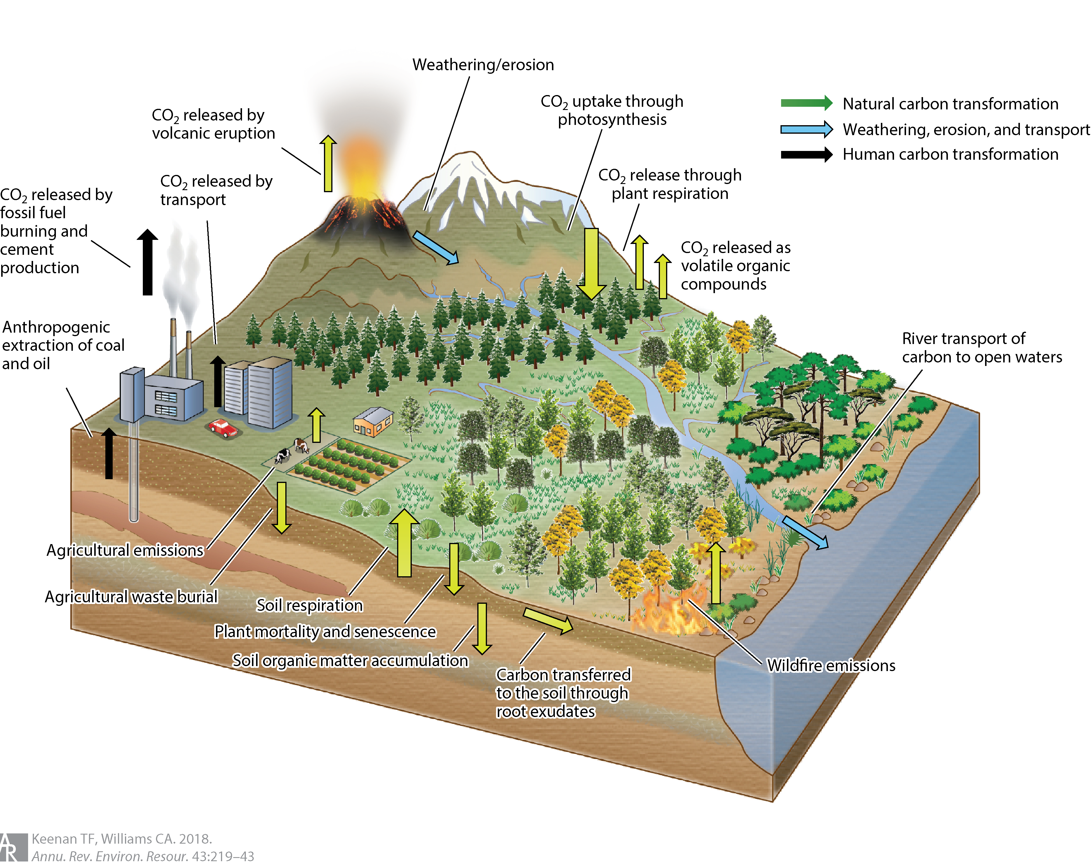
A more detailed depiction of carbon/atmosphere carbon exchange (Keenan & Williams, 2018)
Figure 1 The primary flows and exchanges that constitute the terrestrial carbon cycle, including uptake through photosynthesis, release to the atmosphere through both anthropogenic (fossil fuel emissions, biomass burning, land use) and natural emissions (autotrophic and heterotrophic respiration, wildfires, volcanic eruptions), and weathering, erosion, and transport. Figure modified with permission from Diana Swantek, Lawrence Berkeley National Lab.

Slide 3
A more detailed depiction of carbon/atmosphere carbon exchange (Keenan & Williams, 2018)
“Ecosystems are thus in a perpetual cycle of being knocked away from equilibrium by disturbance, while at the same time the natural equilibrium point is changing due to environmental change. Changes in the disturbance regime, and persistent environmental change can also completely change the playing field by altering ecosystem structure sufficiently to create a regime shift to a new stable equilibrium state.”
Figure 1 The primary flows and exchanges that constitute the terrestrial carbon cycle, including uptake through photosynthesis, release to the atmosphere through both anthropogenic (fossil fuel emissions, biomass burning, land use) and natural emissions (autotrophic and heterotrophic respiration, wildfires, volcanic eruptions), and weathering, erosion, and transport. Figure modified with permission from Diana Swantek, Lawrence Berkeley National Lab.

Slide 4
A more detailed depiction of carbon/atmosphere carbon exchange (Keenan & Williams, 2018)
“Ecosystems are thus in a perpetual cycle of being knocked away from equilibrium by disturbance, while at the same time the natural equilibrium point is changing due to environmental change. Changes in the disturbance regime, and persistent environmental change can also completely change the playing field by altering ecosystem structure sufficiently to create a regime shift to a new stable equilibrium state.”
“Ecosystems exist in a state of dynamic disequilibrium”
Figure 1 The primary flows and exchanges that constitute the terrestrial carbon cycle, including uptake through photosynthesis, release to the atmosphere through both anthropogenic (fossil fuel emissions, biomass burning, land use) and natural emissions (autotrophic and heterotrophic respiration, wildfires, volcanic eruptions), and weathering, erosion, and transport. Figure modified with permission from Diana Swantek, Lawrence Berkeley National Lab.

Slide 5
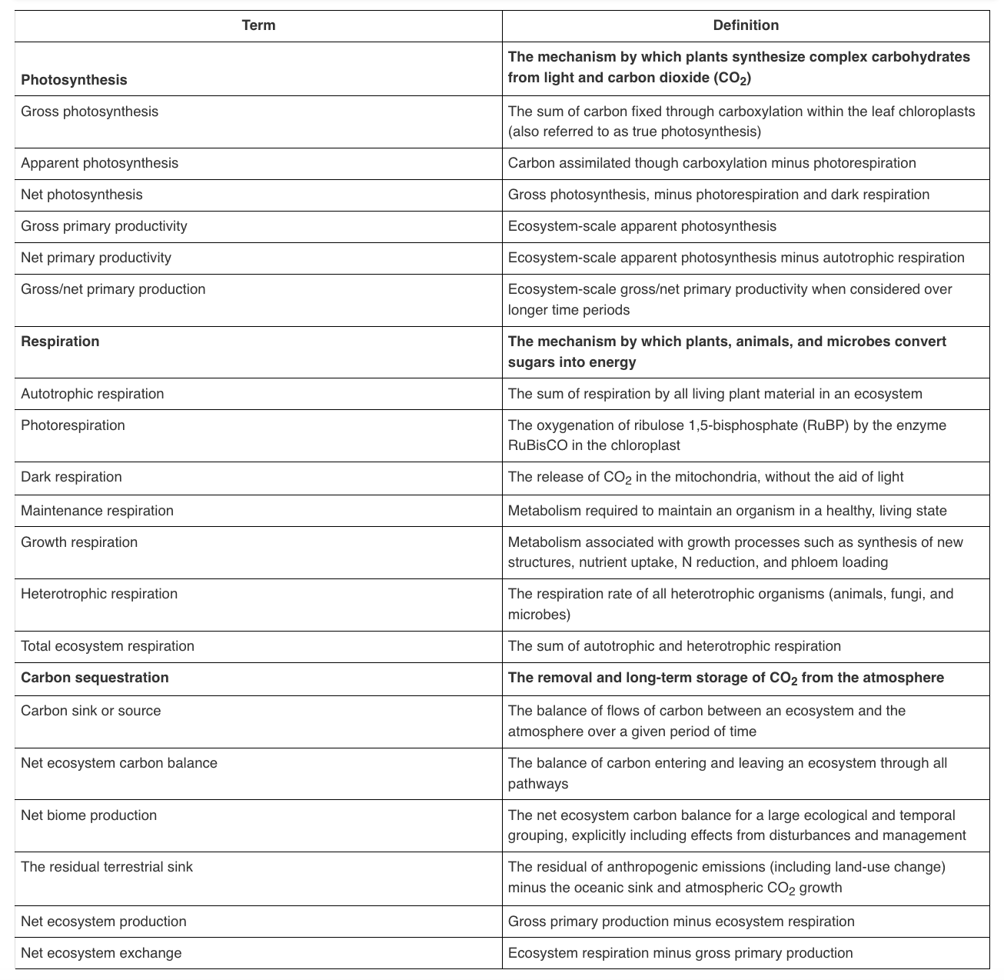
Keenan & Williams provide a nice summary of definitions (Table 1 & subsequent discussion)
Carbon sequestration is the term used to describe the capture and long-term storage of CO2 from the atmosphere. A forest, ocean, or other natural environment has the ability to sequester carbon, through the movement of carbon from short-lived labile pools such as leaves and hummus, to long-lived pools with slow turnover times such as standing biomass or recalcitrant organic matter in soils. The ability to sequester carbon is determined by the balance of time an ecosystem spends being either a sink or a source of carbon, which is defined based on an ecosystems ability to absorb CO2 from the atmosphere. An ecosystem can be a sink for carbon in one year, and a source in another, but must be a sink over long timescales to sequester more carbon.
Although ecosystems are often classified as sinks or sources based on observed fluxes of carbon between an ecosystem and the atmosphere, a true quantification of sink strength must take into account all the pathways of carbon transport, many of which are not represented in observations of exchanges with the atmosphere. Such quantification is termed the net ecosystem carbon balance (NECB; 10) and accounts for all vectors of carbon exchange between an ecosystem and its environment.
“NECB”

Slide 6
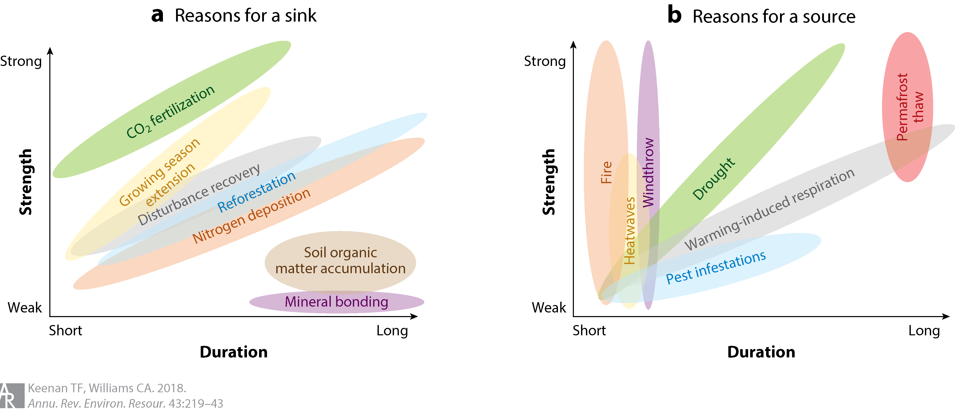
Sources and sinks (still drawing from Keenan & Williams, 2018)
Figure 2 A schematic of the multiple influences responsible for an ecosystem's (a) sink or (b) source magnitude, separated by their strength and duration. Processes such as CO2 fertilization, growing season extension, and recovery from disturbance have been identified as causes of the current global sink, while drought, warming-induced respiration, and disturbances contribute to sink reductions.

Slide 7
Sources and sinks (still drawing from Keenan & Williams, 2018)
The volume of data has opened the door to novel machine-learning techniques, providing unprecedented insights into global carbon cycling by scaling distributed and disparate point-based observations to the global scale.
It has also opened the door to new questions … New approaches are being developed to address potential biases; for example, online isotopic measurements are providing additional insights into the components of the net flux
Figure 2 A schematic of the multiple influences responsible for an ecosystem's (a) sink or (b) source magnitude, separated by their strength and duration. Processes such as CO2 fertilization, growing season extension, and recovery from disturbance have been identified as causes of the current global sink, while drought, warming-induced respiration, and disturbances contribute to sink reductions.

Slide 8
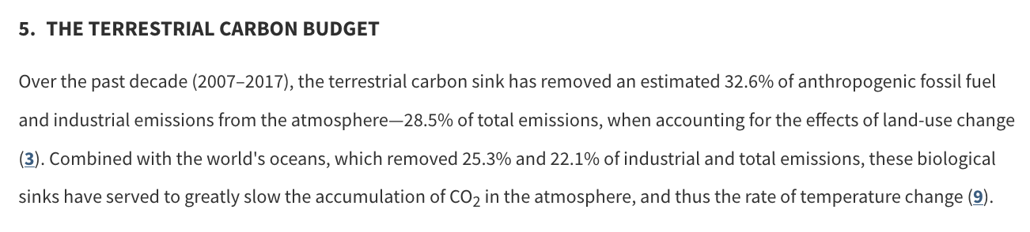
Sources and sinks (still drawing from Keenan & Williams, 2018)
Figure 2 A schematic of the multiple influences responsible for an ecosystem's (a) sink or (b) source magnitude, separated by their strength and duration. Processes such as CO2 fertilization, growing season extension, and recovery from disturbance have been identified as causes of the current global sink, while drought, warming-induced respiration, and disturbances contribute to sink reductions.

Slide 9
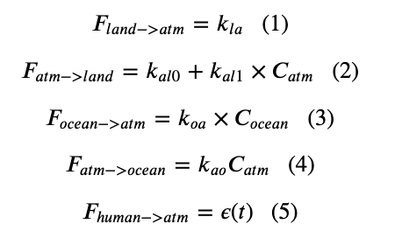
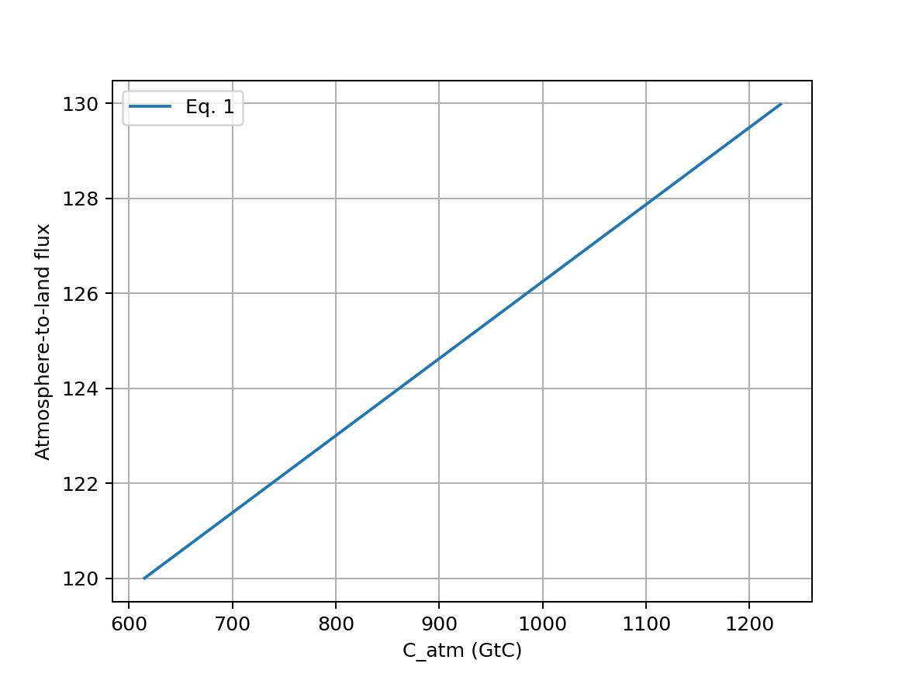




$CO_{2}$ fertilization is proportional to how much CO2 there is in the air
In 2024 ($425 ppm$)
In 2003 ($377 ppm$)
pre-industrial atmospheric $CO_{2}$ ($290 ppm$)

Slide 10
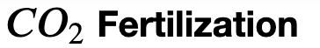
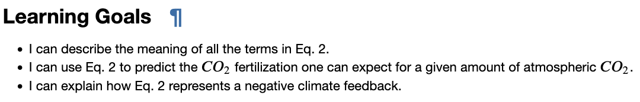
OK, let’s get started
Notes:
Predict the temperature if CO2 continues to rise. If we reduce CO2 emissions to zero.

